Slide 1
Kirill Belyaev Computer Science Department Colorado State University
Towards application-level access control
for localized and loosely coupled
data services
Ph.D. Preliminary Examination [Spring 2016]

Slide 2
Introduction Growing trends
Modern single machine instance can deploy large number of application and data services
UNIX based OS is a good candidate
Services can be deployed within Isolated Runtime Environments (IRE)
IRE can have all the necessary libraries and components for service deployment

Slide 3
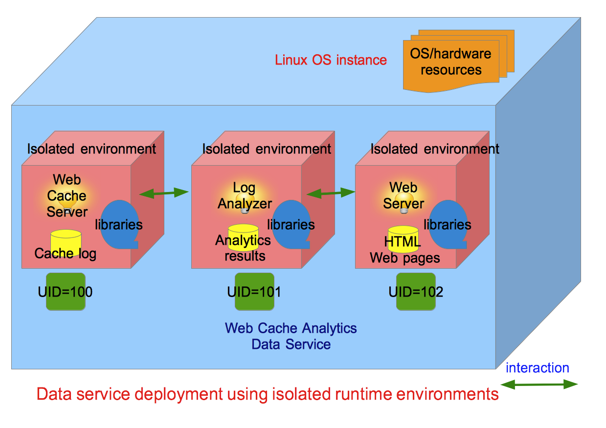
Introduction Sample deployment
A single data service can be partitioned into several tiers

Slide 4
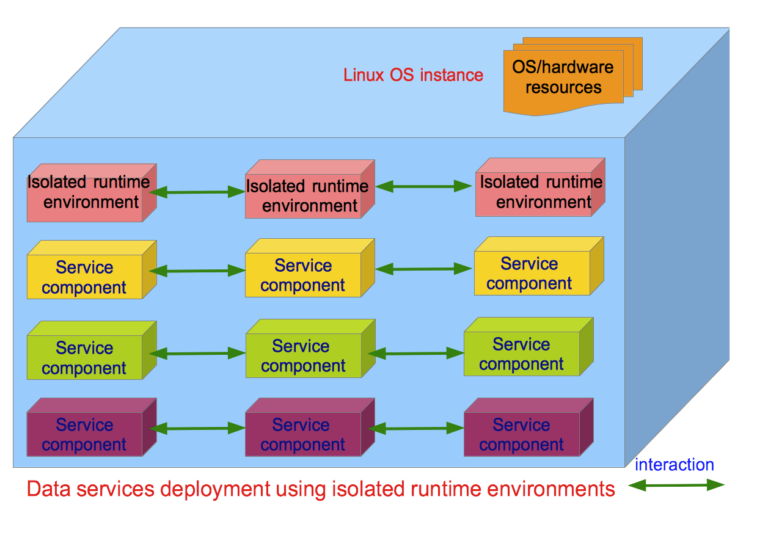
Introduction Sample deployment (2)
Single OS can host hundreds of multi-tier data services deployed on a single machine

Slide 5
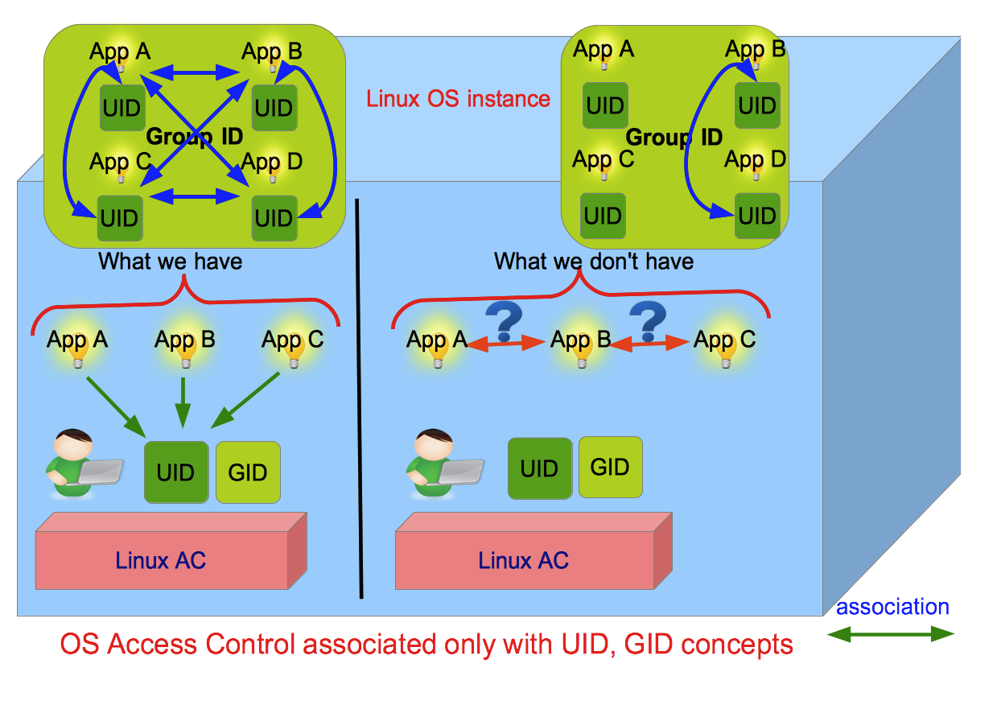
Problem Limitations of OS Access Control
Linux OS has no concept of application-level Access Control

Slide 6
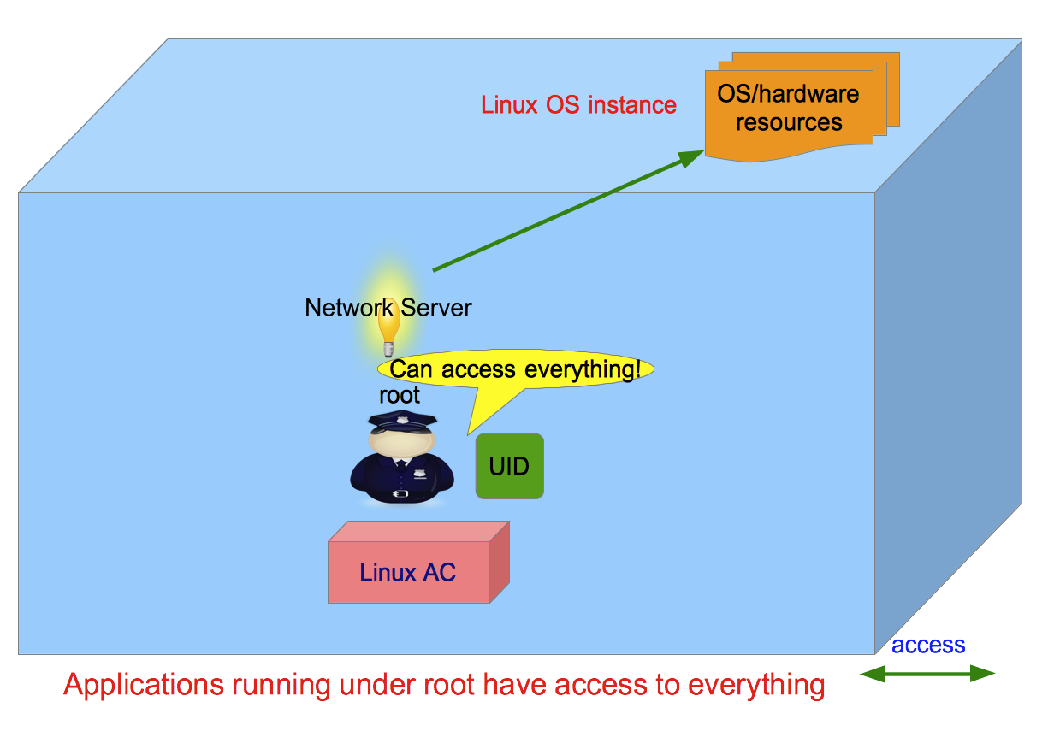
Problem Privilege escalation
Applications deployed with super-user privileges make them not bound to normal Access Control rules

Slide 7
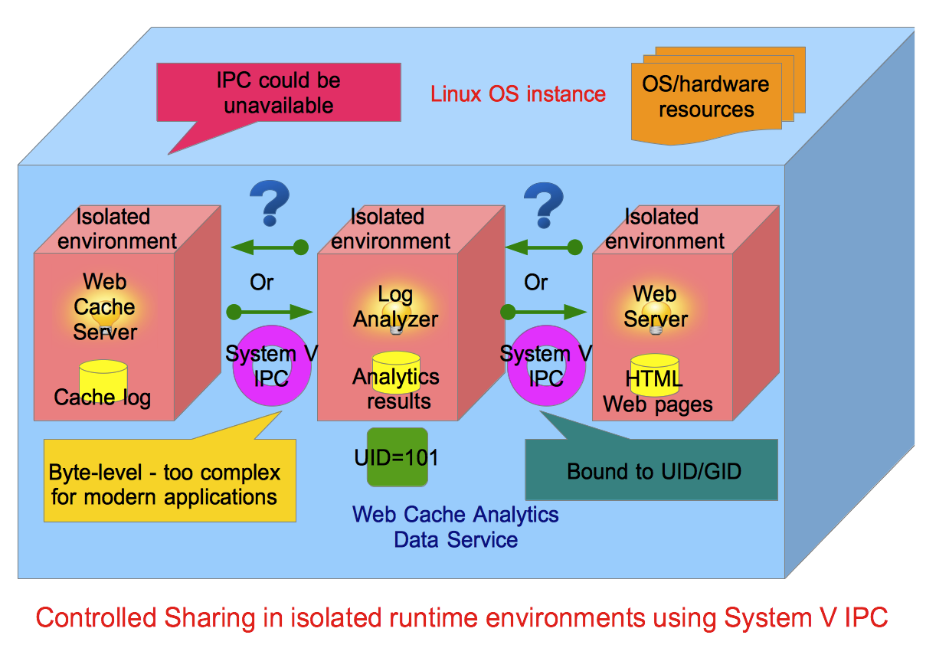
Problem Limitations of UNIX IPC
UNIX System V Inter-Process Communication (IPC) does not offer regulated way of inter-application interaction

Slide 8
Motivation
How to provide Access Control (AC) at the granularity of individual applications?
How to confine applications with minimum privileges without running them with super user privileges?
How to enable controlled application interaction across isolated runtime environments (IREs) without reliance on conventional UNIX IPC mechanisms?
How to provide manageable user-space AC interface for a large number of data services?

Slide 9
Proposed Research
Develop a novel object-oriented framework for application-level AC in Linux:
Capabilities Policy Class Model – enables management and enforcement of application-level resource control
Communication Policy Class Model – enables management and enforcement of controlled inter-application interaction across isolated runtime environments
Unified framework – combines both models in a unified abstraction

Slide 10
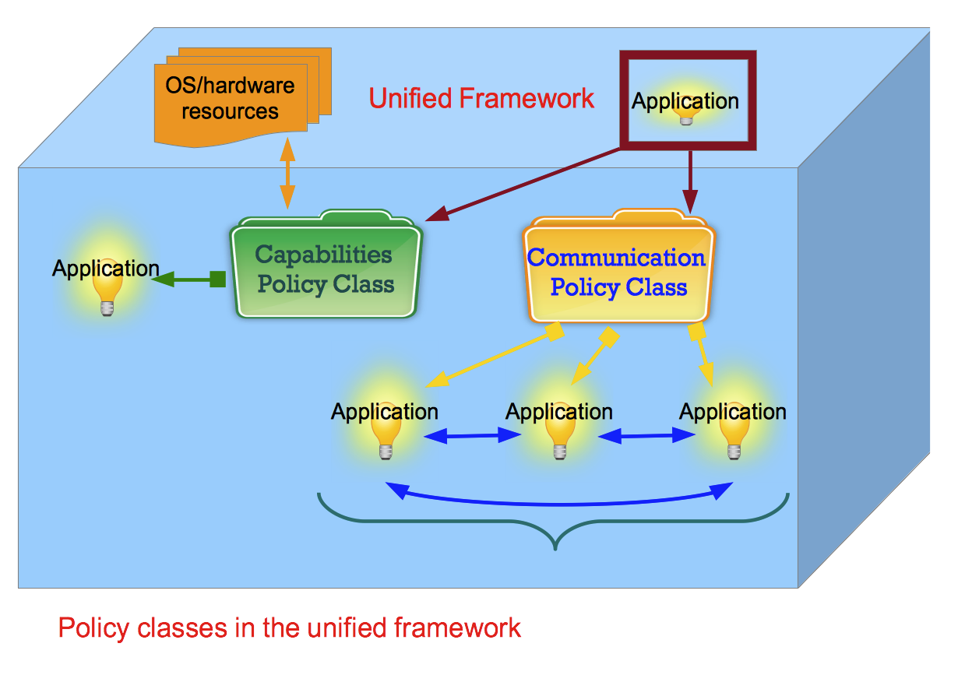
Proposed Research Unified Framework
2 types of policy classes to provide application-level Access Control

Slide 11
Outline
Capabilities Policy Class Model
Communication Policy Class Model
Architecture
Proposed Evaluation

Slide 12

Capabilities Policy Class Model

Slide 13
Capabilities Policy Class Model What we have
Access to OS/hardware resources is managed through kernel-space Linux (POSIX) capabilities
Capabilities split up super user privileges into independent fragments
Capabilities can manage resource control on the principle of least privilege
No user-friendly management layer to manage capabilities

Slide 14
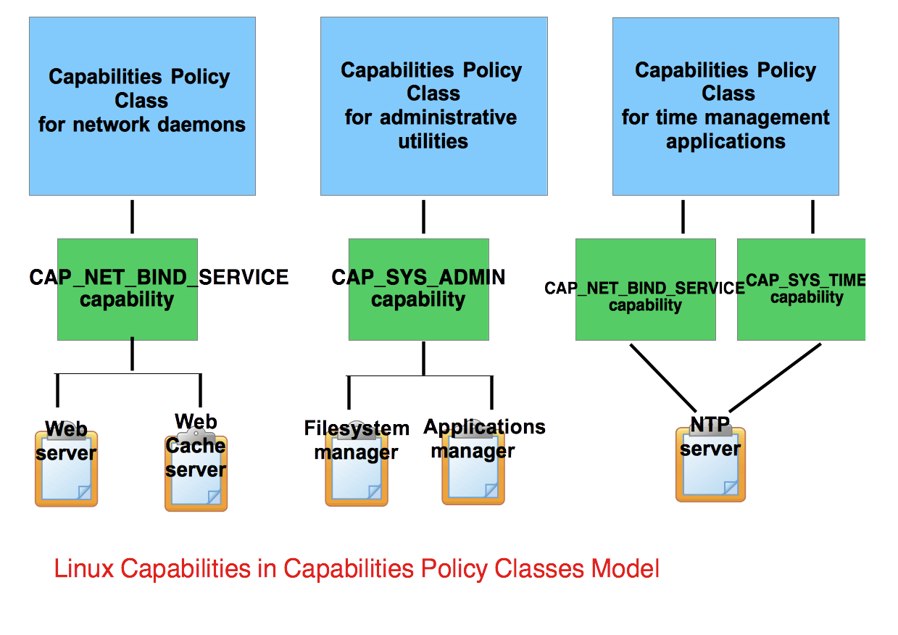
Capabilities Policy Class Model What we need
Capabilities could be grouped into various policy classes

Slide 15
Capabilities Policy Class Model Operations
The following high-level operations are proposed:
create a capabilities policy class
add/remove capabilities to/from a policy class
show capabilities in a policy class
add/remove applications to/from a policy class
show/count apps in a policy class

Slide 16
Capabilities Policy Class Model Sample usage
Here is how the model is used in practice:
SHOW_CAPABILITIES;
SHOW_POLICY_CLASSES;
CREATE_POLICY_CLASS 1 general_applications_policy_class;
ADD_POLICY_CLASS_POLICY 1 CAP_KILL;
ADD_POLICY_CLASS_POLICY 1 CAP_CHOWN;
MOVE_APP_TO_POLICY_CLASS /containers/A/apps/app-A 1;
REMOVE_POLICY_CLASS_POLICY 1 CAP_CHOWN;
SHOW_POLICY_CLASS_POLICIES 1;
SHOW_POLICY_CLASS_APPS 1;

Slide 17
Communication Policy Class Model

Slide 18
Communication Policy Class Model What we have
A group of applications may provide a single data service
A single application can be partitioned into a set of compartments
Applications in separate isolated runtime environments (IREs) need to communicate
Communication often involves sharing of data objects

Slide 19
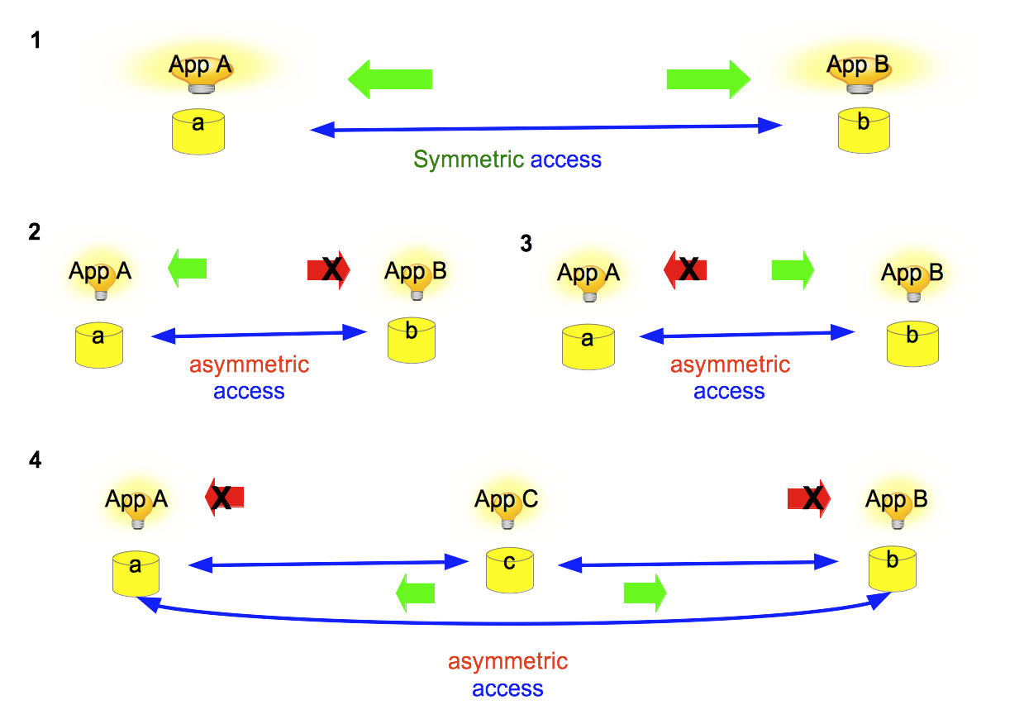
Communication Policy Class Model What we need
Provide symmetric (bidirectional) access to data objects
Provide only asymmetric (unidirectional) access to data objects

Slide 20
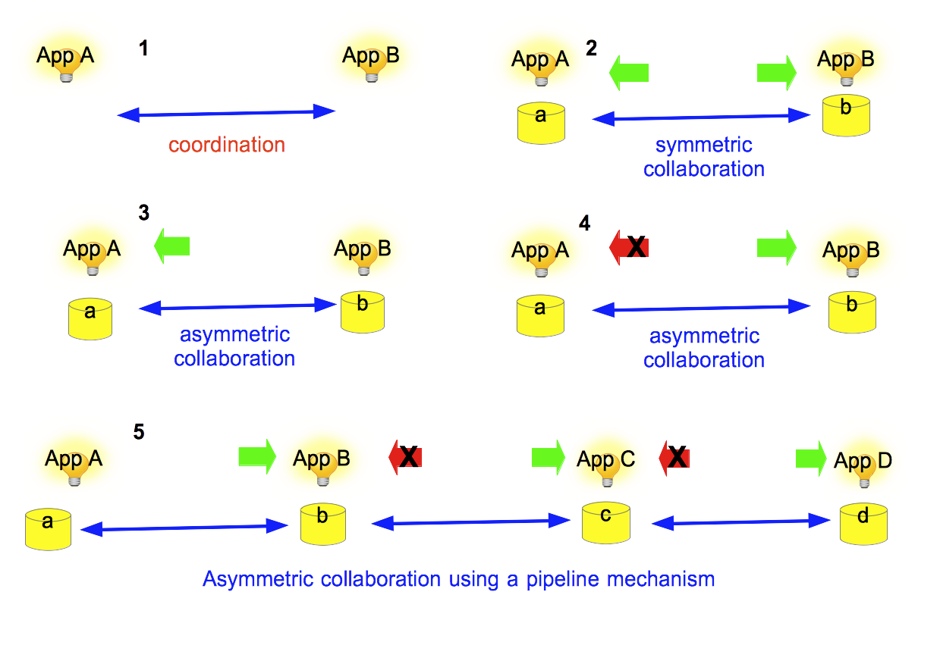
Communication Policy Class Model Types of Communication
Group of applications may:
Coordinate - exchange of coordination messages
Collaborate - share mutual data objects

Slide 21
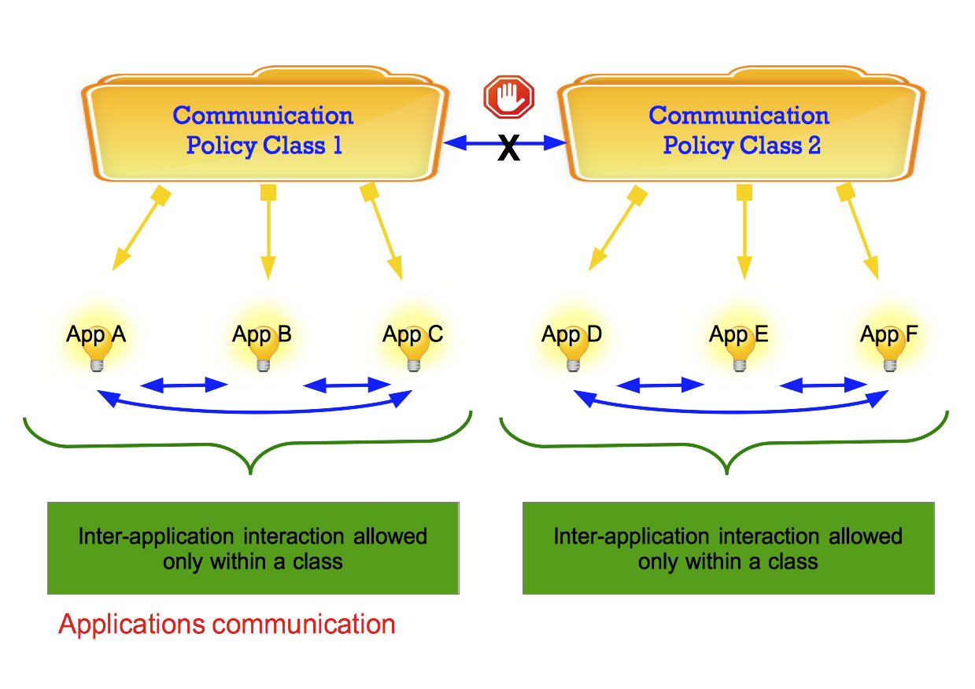
Communication Policy Class Model Properties
Group of applications can communicate only within the same class

Slide 22
Communication Policy Class Model Operations
The following high-level operations are proposed:
create a communication policy class
add/remove applications to/from a policy class
show/count apps in a policy class
add/remove associations of an app to a data object(s) to/from a policy class
enable/disable application coordination with other application(s) in a policy class

Slide 23

Architecture

Slide 24
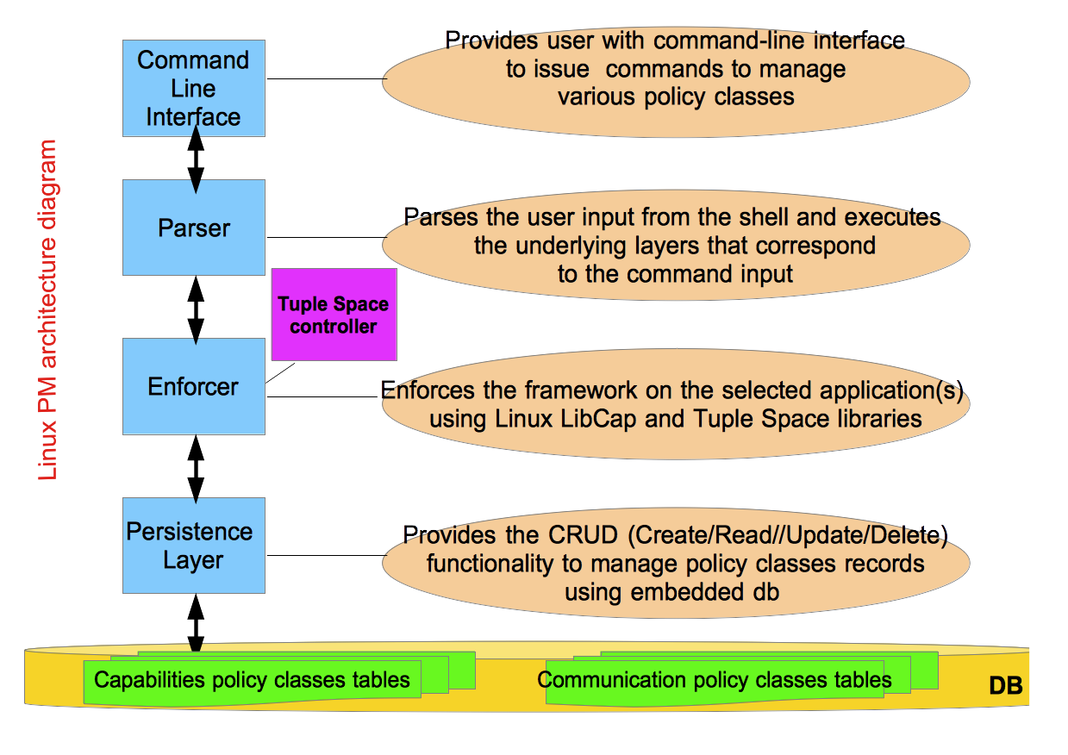
Architecture System design (1)
Unified framework proposed in the form of Linux Policy Machine

Slide 25
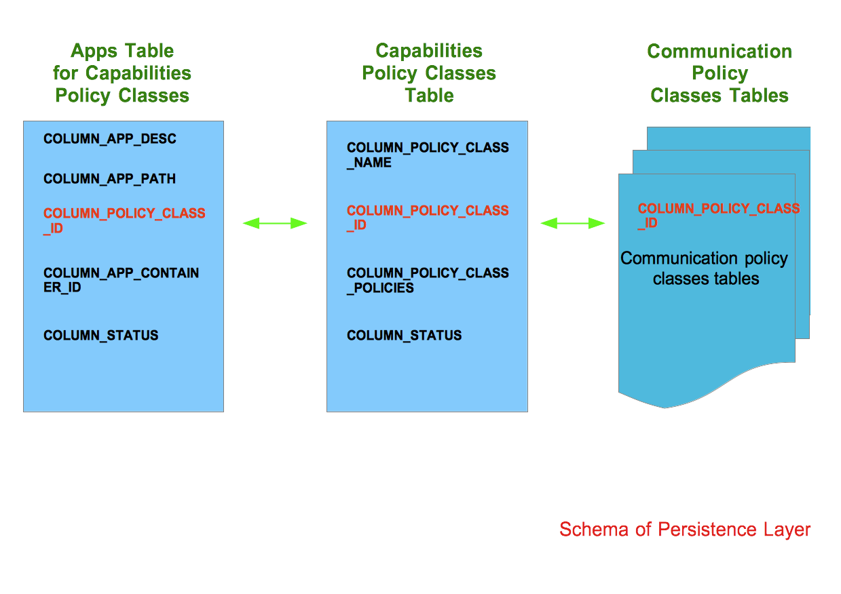
Architecture System design (2)
Unified framework stored in the embedded Sqlite database

Slide 26
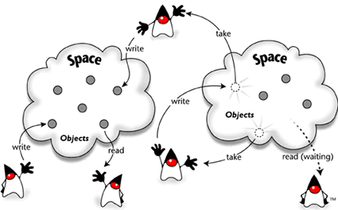
Architecture Communication design (1)
Adapt indirect communication paradigm - tuple space to enforce decoupled inter-application interaction

Slide 27
Architecture Communication design (2) - Limitations
The basic model relies on a global shared RAM tuple space
Has number of issues:
Tuple collisions could happen
Wide array of possible security attacks
Overheads of memory utilization
Could be inaccessible due to access control policies
Suitable mainly for a single application with multiple threads

Slide 28
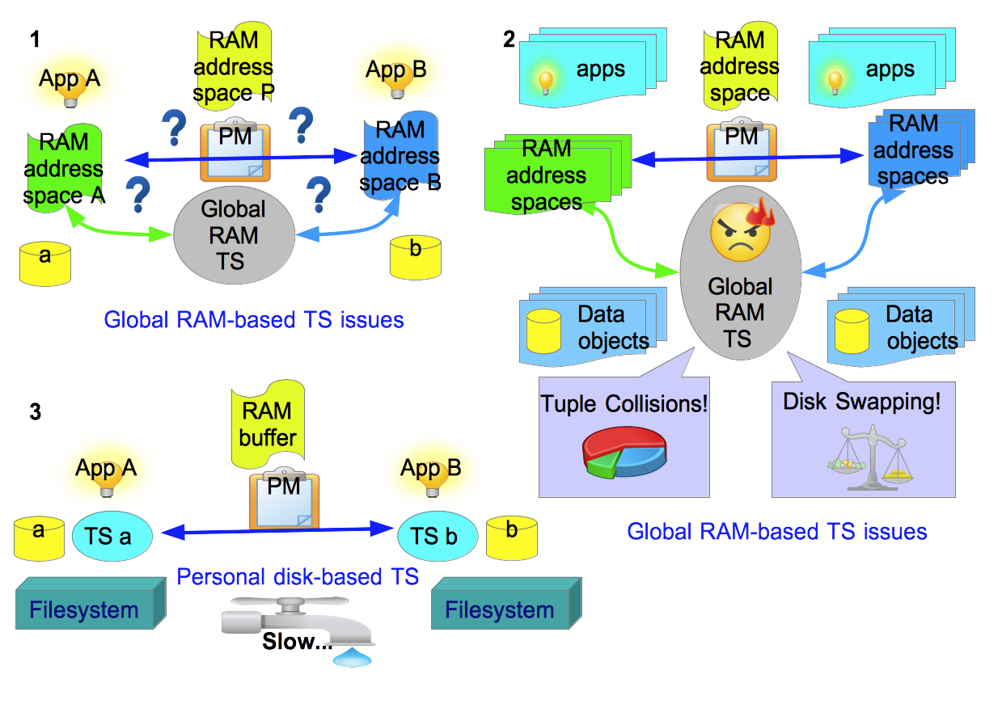
Architecture Communication design (3) - Adaptation
Personal tuple space per application
Disk/flash based implementation

Slide 29
Architecture Communication design (4) - Operations
Propose a set of tentative operations - tuple space calculus:
create tuple space
delete tuple space
read operation - returns the value of individual tuple without affecting the contents of a tuple space
append operation - adds a tuple without affecting existing tuples in a tuple space
take operation - returns a tuple while removing it from a tuple space

Slide 30
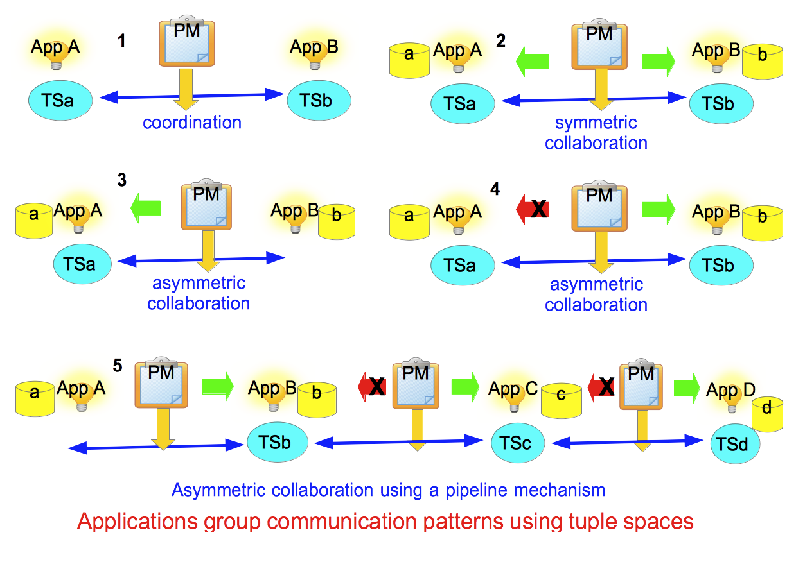
Architecture Communication design (5) - Patterns
Application allowed to perform all calculus operations
Policy Machine restricted to read and append operations

Slide 31
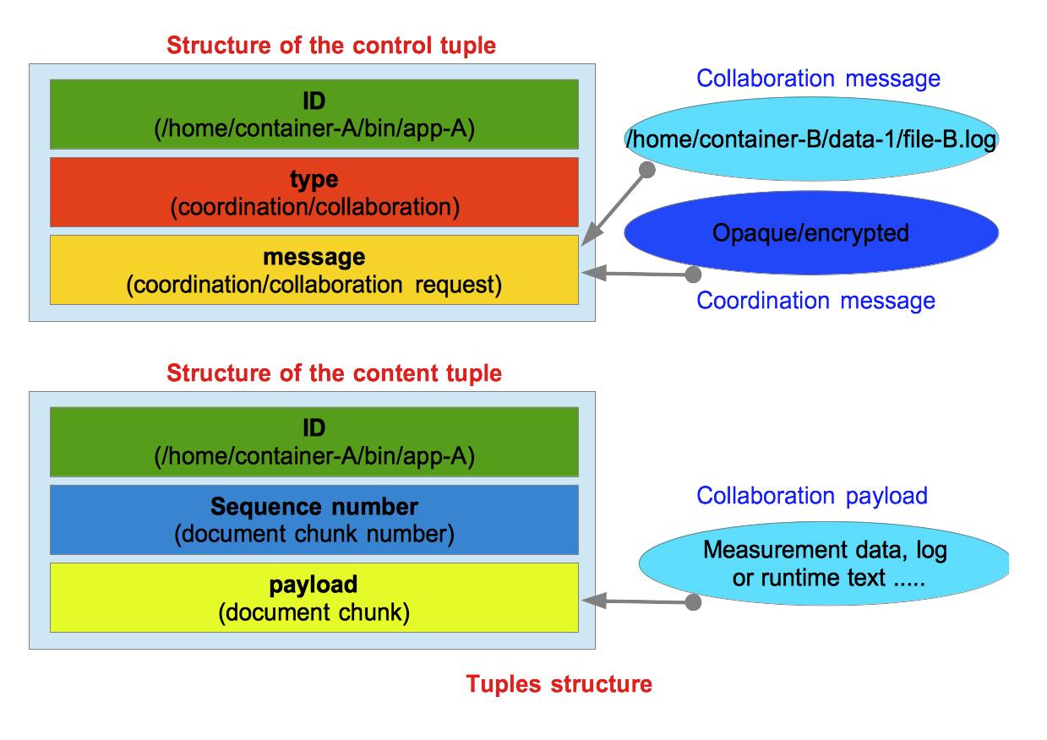
Architecture Communication design (6) – Tuple Types
Control tuples - provide the instructions about coordination or sharing
Content tuples - mechanism by which data gets shared across applications

Slide 32
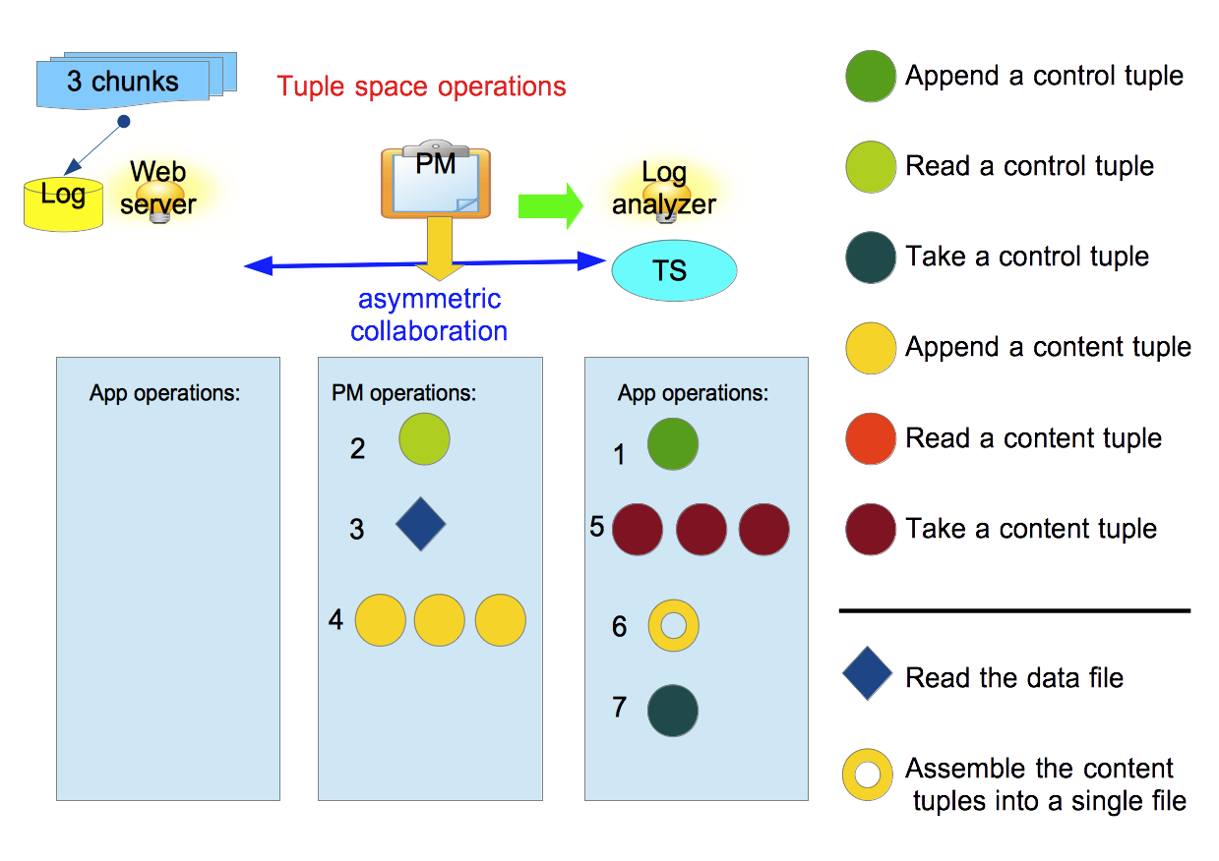
Architecture Communication design (7) – Sample Transaction
Policy machine periodically checks for the presence of control tuples

Slide 33
Proposed Evaluation
Capabilities policy classes do not incur performance overhead
no extra disk I/O aside from the I/O load of the base system
no additional memory utilization
Communication policy classes are resource intensive
Evaluate performance with integrated tuple space controller:
Sizes of mediated data objects | Number of communicating applications
Disk I/O utilization | Disk I/O utilization
CPU utilization | CPU utilization
RAM utilization | RAM utilization

Slide 34
Summary
Unified Framework consists of:
model of Capabilities Policy Classes – regulates Linux capabilities on a per-application granularity
model of Communication Policy Classes - regulates inter-application interaction
Enforcement of the framework is done via:
Capabilities model – Linux LibCap library
Communication model – tuple space library/controller (to be developed)
Targets deployment of decoupled data services on multi-core server instance

Slide 35
Future Work
Address the distributed deployment of unified framework
Address the problems of policy representation and validation
Investigate memory-resident tuple space(s) implementation
Investigate scalability issues

Slide 36
Expected Contributions
1. A state-of-the-art survey on existing access control solutions in Unix/Linux environments
2. Model for capabilities based management and enforcement that uses policy classes abstraction
3. Model for inter-application interaction that uses policy classes abstraction
4. Unified framework for localized deployment
5. Proof of concept of the framework that includes proposed schemes/models
6. Evaluation of run-time properties of implemented framework

Slide 37
Research Plan

Slide 38
Publications
Kirill Belyaev and Indrakshi Ray, “Empowering applications with Seshat for processing of XML data and control streams”, to be submitted to 20th International Database Engineering & Applications Symposium, IDEAS 2016, February 2016
Kirill Belyaev and Indrakshi Ray, “Towards application-level access control for localized and loosely coupled data services”, submitted to 31st IFIP International Conference on Systems Security and Privacy Protection, SEC 2016, January 2016
Kirill Belyaev, Wuliang Sun, Indrakshi Ray, and Indrajit Ray, “On Design and Analysis of Protocols for Personal Health Record Storage on Personal Data Server Devices”, revision submitted to The International Journal of Future Generation Computer Systems, FGCS Journal, January 2016
Kirill Belyaev and Indrakshi Ray, “Towards Efficient Dissemination and Filtering of XML Data Streams”, in proceedings of 13th IEEE International Conference on Dependable, Autonomic and Secure Computing, DASC 2015, Liverpool, UK
Kirill Belyaev, Indrakshi Ray, Indrajit Ray, Gary Luckasen, "Personal health record storage on privacy preserving green clouds”, in proceedings of 9th IEEE International Conference on Collaborative Computing: Networking, Applications and Worksharing, CollaborateCom 2013, Austin, USA
Indrajit Ray, Kirill Belyaev, Mikhail Strizhov, Dieudonne Mulamba, Mariappan Rajaram, "Secure Logging as a Service - Delegating Log Management to the Cloud”, IEEE Systems Journal 7(2) 2013

Slide 39

Thank you for your attention!
Questions?

Slide 40
Capabilities Policy Class Model Sample capabilities
Linux capabilities for instance include:
CAP_AUDIT_CONTROL - Enable and disable kernel auditing; change auditing filter rules; retrieve auditing status and filtering rules
CAP_DAC_OVERRIDE - Bypass file read, write, and execute permission checks
CAP_IPC_LOCK - Lock memory (mlock(2), mlockall(2), mmap(2), shmctl(2))
CAP_NET_ADMIN - Perform various network-related operations such as: interface configuration; administration of IP firewall, masquerading, and accounting; modify routing tables; bind to any address for transparent proxying; set type-of-service (TOS); clear driver statistics; set promiscuous mode; enabling multicasting; use setsockopt(2) to set the advanced socket options
CAP_SYS_BOOT - Use reboot(2) and kexec_load(2) system calls

